Slide 1

Competitive Programming From Problem 2 Solution in O(1)
P
T
H
I
N
K
F
A
S
T
S
C++: Headers and Includes
Mostafa Saad Ibrahim
PhD Student @ Simon Fraser University

Slide 2
Code for me!
Imagine you are building an application, and need to compute
Matrix determienat and
Sort set of numbers and
Compress an image and
Use integers of 100 digits and ...
Do you plan to code all of that by yourself?
Do you think these sub-problems are general?
People can help each others!

Slide 3
Libraries
People implemented many general projects
To use someone implemented code, you use #include
Some libraries are by default in C++...others you download and use
To use a library
Download it (if external one)
Link against it
Include it in your code => Let’s talk about that

Slide 4
Example: #include <cmath>
#include (Include directive) means use an available code
Think that it copies code written for you inside your code. We call it cmath header
cmath includes many math utilities to use
sin, tan, acosh, exp, log, modf, pow, sqrt, ceil, round, hypot, nan, fabs, isnan, ....and more

Slide 5
Example: #include <iostream>
This includes the reading/writing functionality
Remember, you read using cin from keyboard
So we need some low-level code that interact with hardware...this is written for you ☺
Stream means flow of bytes
Iostream => Input-Output flow of bytes

Slide 6
C++ Standard Library header files
There are too many headers defined for you
Knolwedge is power..read to know
Examples: algorithm, functional, utility, ctime, climits, cassert, iomanip.
STL library has more and more (later)
#include<math.h> => This is C, deprecated, avoid to use
Instead use <cmath>

Slide 7
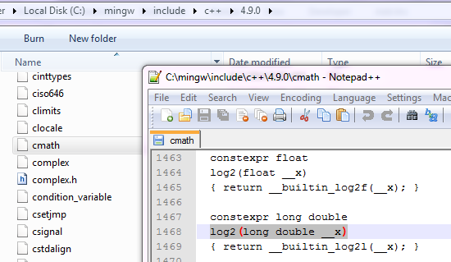
C++ library on harddisk

Slide 8
Writing in headers
What if still my project has too many functions and code?
Should all of that be in 1 file?
What If want to do some staff and give it to others to use?
Let’s make our own headers!

Slide 9
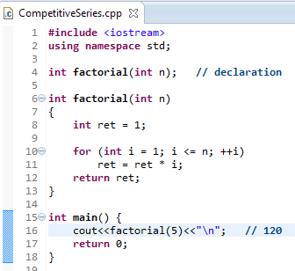
We used to do

Slide 10
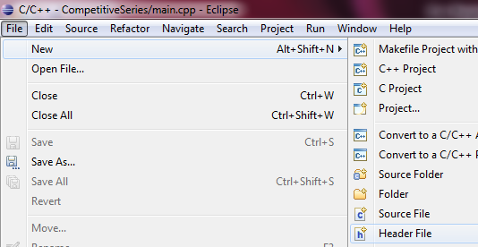
File -> New -> Header File

Slide 11
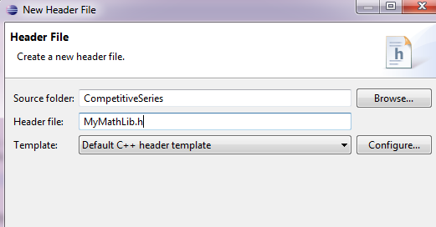
Give a name (.h)

Slide 12
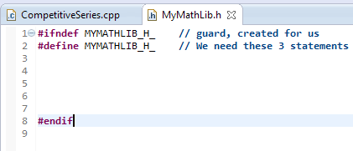
Created File
Why this gurad?
In future, you will know we can include same file many times
But if same function repeated, compile will complain
These lines force it to be created includes ONCE only

Slide 13
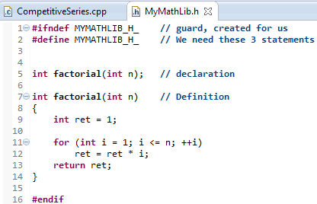
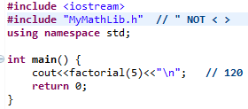
Write code => include it
Also divide your big code to
headers
Now, give people your code
to use

Slide 14
Header and its implementation
You know a C++ function on windows may be written a bit different for linux?
You know that C++ may have versions from time to time? E.g. 4.4 version, 4.9?
You can have same interface (header – functions declaration), but many implementations!
Let’s do out own example

Slide 15
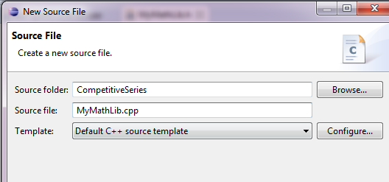
File -> New -> Source File

Slide 16
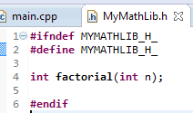
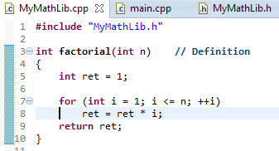
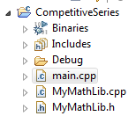
Header and its implementation

Slide 17
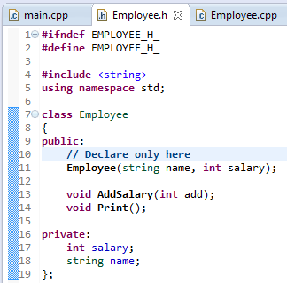
Header for Employee class

Slide 18
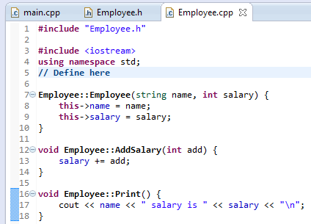
Implementation for Employee class

Slide 19
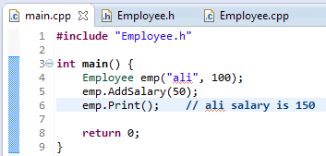
Usage of Employee class
Never include .cpp file...ONLY .h file
Who ever need the declaration must include header

Slide 20
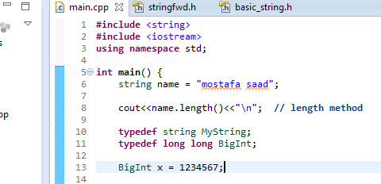


String class

Slide 21
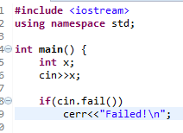

cin and cout
We use them since long time
They are defined objects of type stream for us .. same as we did in struct/class last time

Slide 22
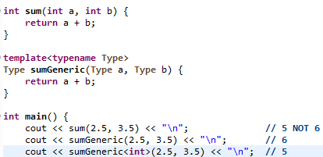
STL (Standard Template Library)
Remember the template keywork?
Templates = generic programming (of type)

Slide 23
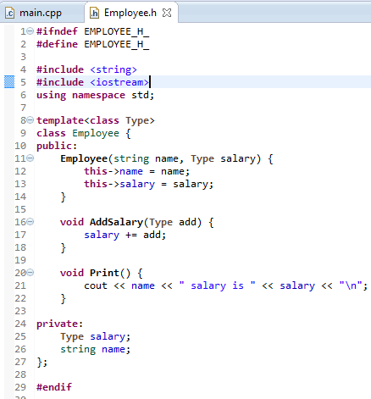
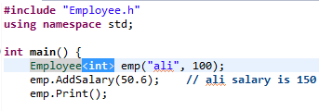
Employee class with template

Slide 24
Name Collisions
Imagine we downloaded some libraries and used them
Say you defined global “counter”
However, one of used libraries has such variable too
This causes problem.
Namespaces allow us to group our things together. If each library has its own namespace, we reduce the problem

Slide 25
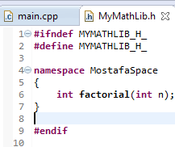
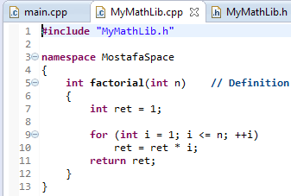
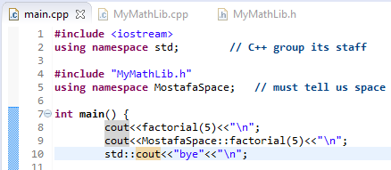
Namespace example

Slide 26
Using namespace xxx is bad
In fact, using namespace something did not solve the problem. As simply, it includes everything.
So, in real life development it is prohibted.
Part of solutions
Either use directly namespace::whatever
Use namespace declaration

Slide 27
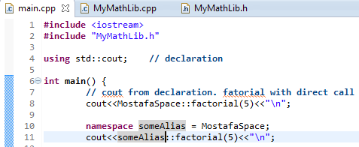
Namespace professional usage

Slide 28
Future reading
Headers and Includes: Why and How
Forward Declaration
Imagine 2 classes depend on each other (e.g. Circualr depenency!)

Slide 29
تم بحمد الله
علمكم الله ما ينفعكم
ونفعكم بما تعلمتم
وزادكم علماً

